Slide 1


Import Container Availability Prediction
Team B-04:
Aditi Sharma
Fan Chen
Hsing Yuan
Sreerag Raghunathan

Slide 2
Objective
To build a predictive model to establish a baseline of import container availability by analyzing a sample of import containers arriving at Ports America’s WBCT container terminal, and identify outliers and factors contributing to import container availability variation.
Value
The business model’s predictions would result in
Controlled budget
Reduced waste within the operational cycle
Improvement in overall service quality
Reduced losses in import container volume revenue

Slide 3
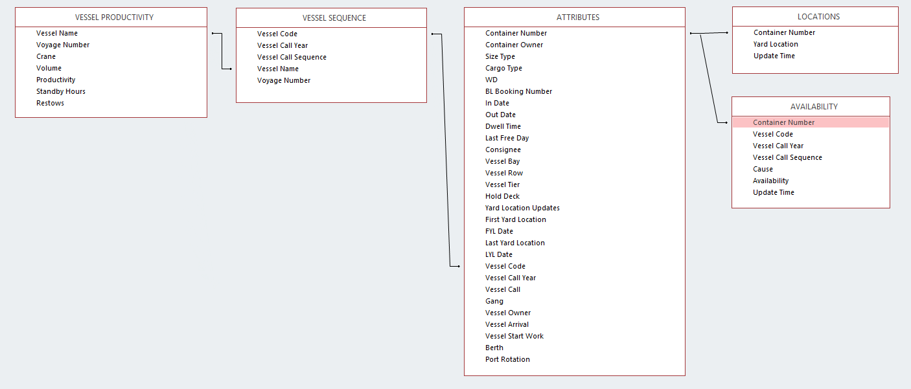
Dataset
Data available from TOS (M21) and VPS systems:
Availability
Attributes
Locations
Vessel Productivity
Vessel Sequence
Functional Dataset : Combination of all 4

Slide 4
Feature Selection & Extraction
Attribute Name | Description | Data Type
Vessel positions | Import container's bay, row, and tier position on the vessel | Numeric
Yard location updates | Number of changes in location from first yard location update to last yard location update | Numeric
Volume | Calculated for each vessel type (group by vessel type) from given number of container lifts (both discharge and loadout) completed by each crane working against the vessel | Numeric
Restows | Total number of container moves that had to be shifted on vessel in order to accommodate the discharge and loadback of the vessel over the course of its visit to the terminal | Numeric
Standby hours | Number of non-productive hours or hours where vessel operations ceased over the course of the vessel's visit to the terminal | Numeric
Availability time (Output) | Duration in days of the container at the terminal (obtained from subtracting Out_Time - In_Time) | Numeric
Notes:
Vessel capacity

Slide 5
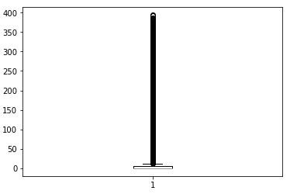
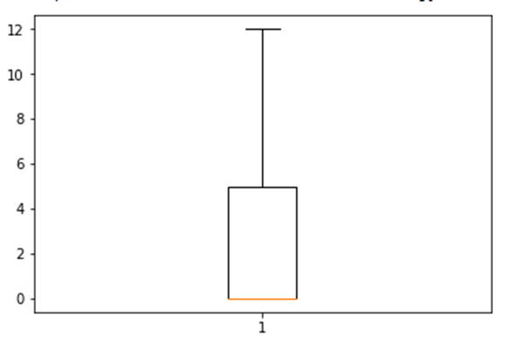
Missing Value Treatments
Missing values ~ 0.7%
Listwise deletion (assumed data MAR)
Deleted values
Values varying from 0 days to 400 days
Values > 15 days in output column (~15%) deleted
Cause of discrepancy : incorrect/late data entry
Split Data
Training : Test = 60 : 40
Model trained on training dataset and predictions made on test dataset
Notes:
0.7% values were missing
split data, type of algorithm

Slide 6
Approach
Missing Value Treatment
Prediction on Test Dataset
Trained Dataset
Boosted Decision Tree Algorithm
Feature Selection & Extraction

Slide 7
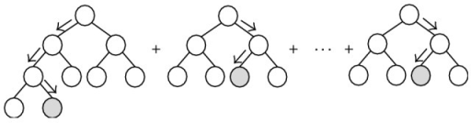
Model
Created non-linear model using boosted decision tree regression algorithm
Boosted Decision Tree Regression
Ensemble of regression trees using boosting - each tree is dependent on prior trees, and learns by fitting the residual of the trees that preceded it.
Improved accuracy vis-à-vis other techniques - linear regression, random forest, Bayesian linear regression

Slide 8
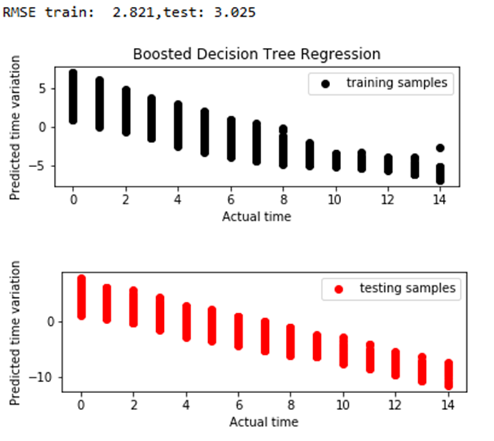
Key Results

Slide 9
Findings
Predictive accuracy of the model built : span of 3 days
Prediction accuracy depends on
Vessel Position
Yard movements
Vessel operational efficiency
15% of the data provided is outlying due to invalid data entry or late data entry
Future Scope
Currently, uniform probability distribution of vessel efficiency is assumed because of data limitation.
This can be further improved from an empirical vessel efficiency probability distribution model w.r.t. container position within the vessel.

Slide 10
Thank You!

